Slide 1
Tutorial Week 10
谭俊杰 Junjie Tan 12332175

Slide 2
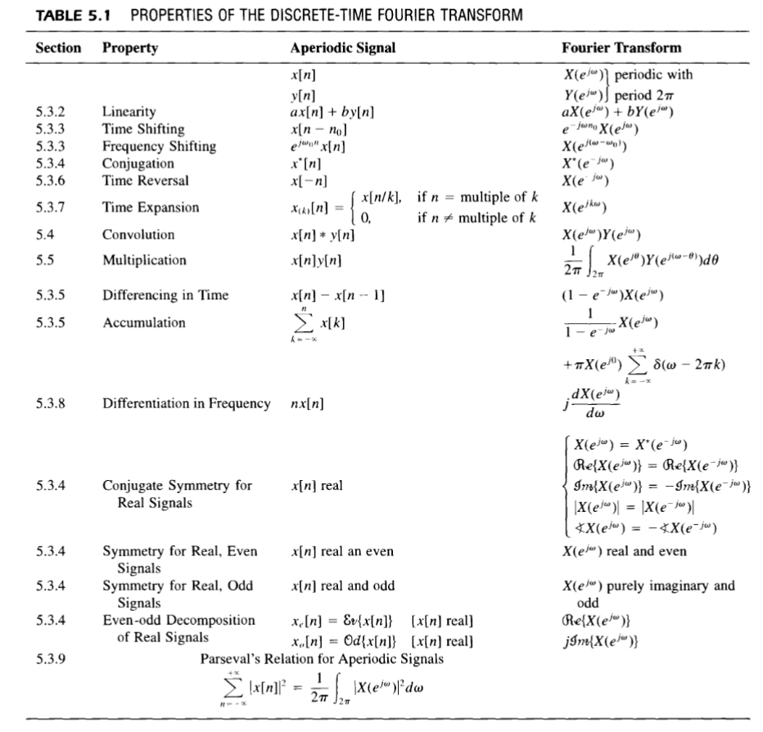

Slide 3
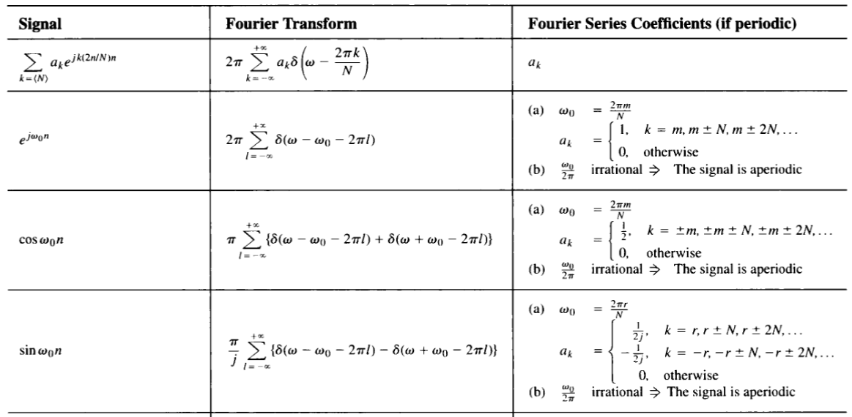
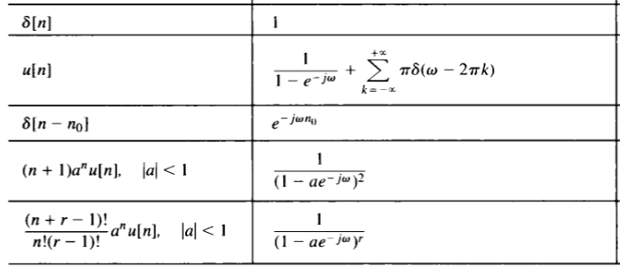
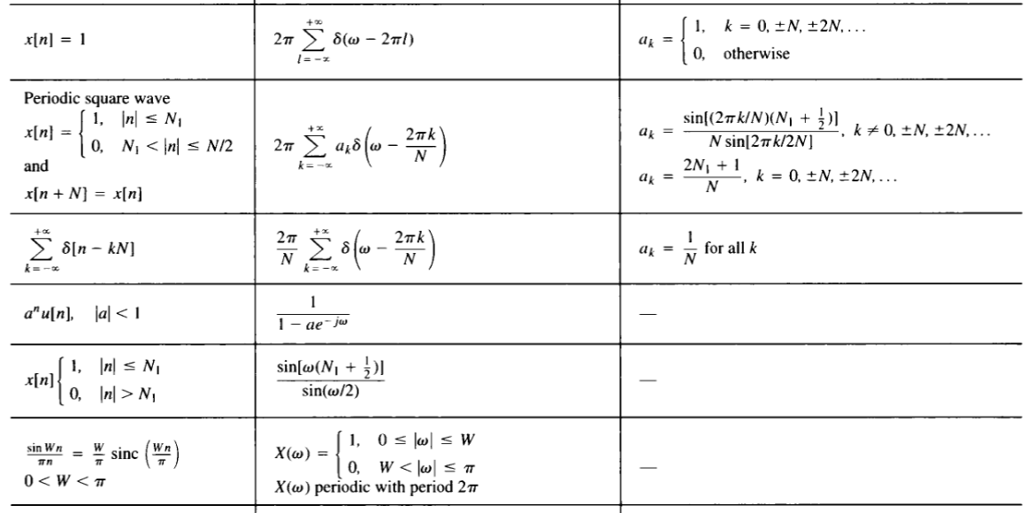

Slide 4
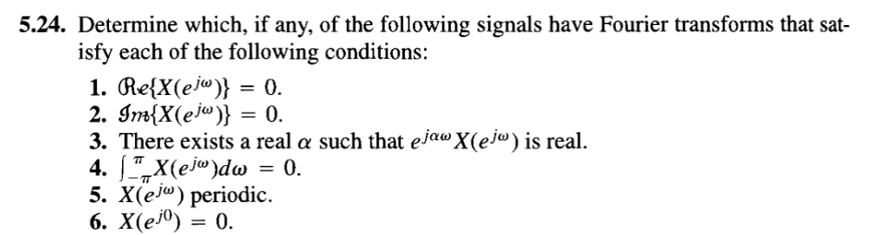
Odd
Even
Shifted even
x[0]=0
Discrete
No DC

Slide 5
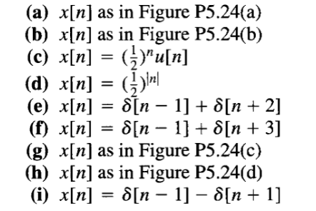
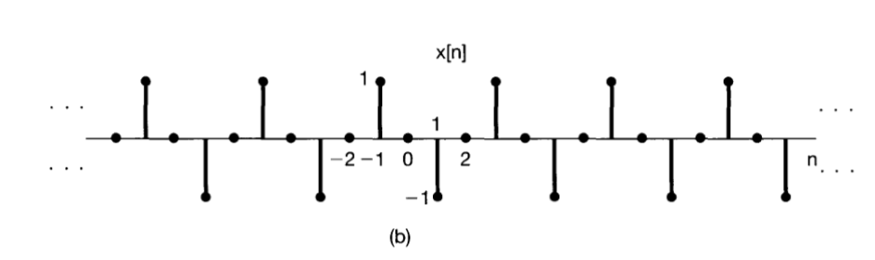
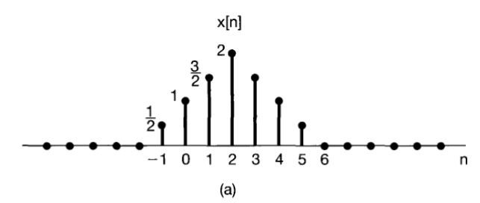
Odd
Even
Shifted even
x[0]=0
Discrete
No DC

Slide 6
Odd
Even
Shifted even
x[0]=0
Discrete
No DC

Slide 7
Odd
Even
Shifted even
x[0]=0
Discrete
No DC
-3
-2
-1
0
1
-3
-2
-1
0
1
-3
-2
-1
0
1

Slide 8
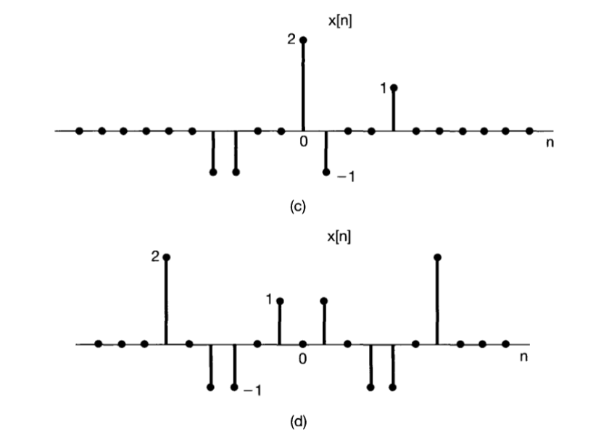
Odd
Even
Shifted even
x[0]=0
Discrete
No DC

Slide 9
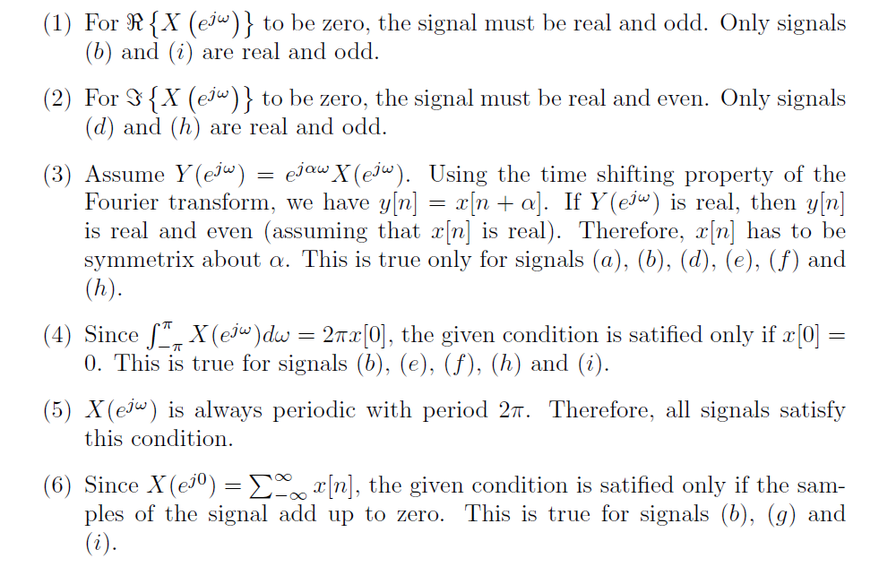

Slide 10
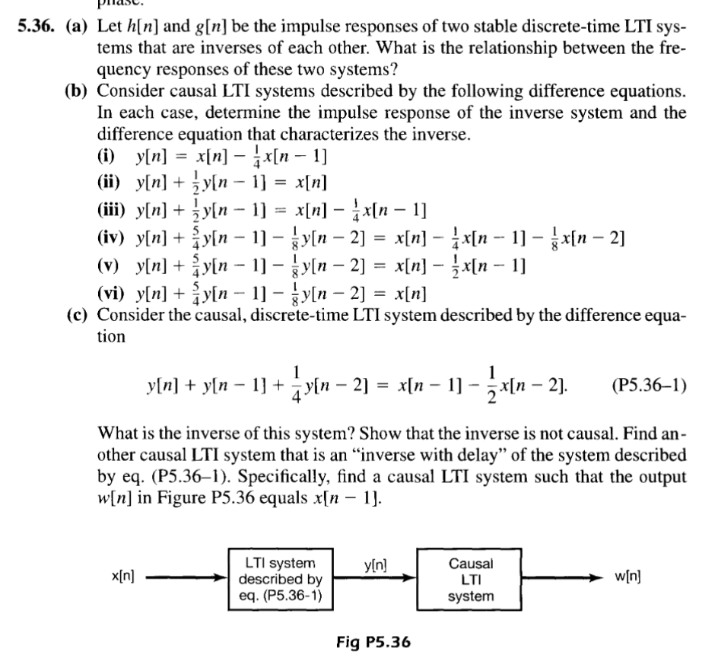

Slide 11
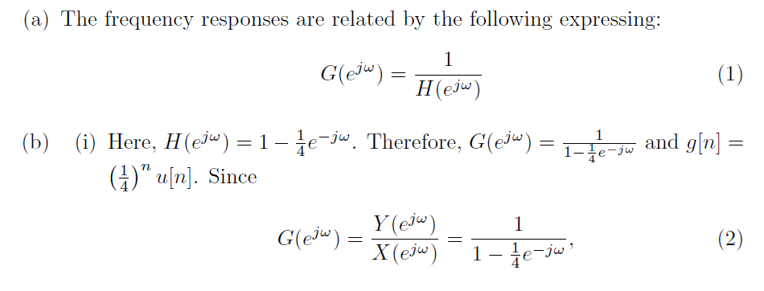
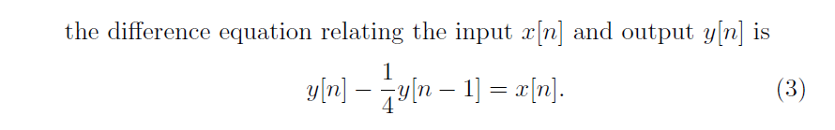

Slide 12
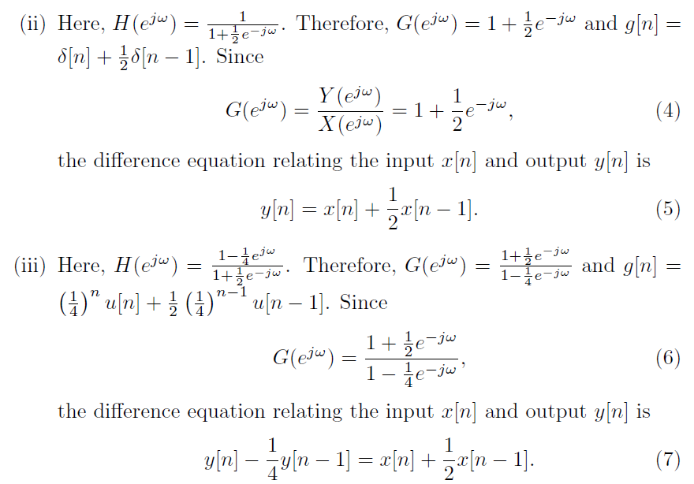

Slide 13
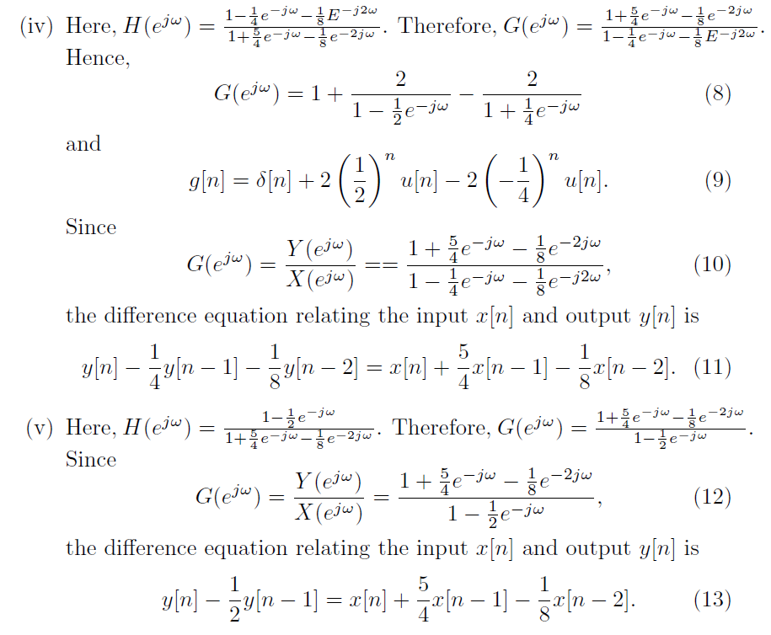

Slide 14
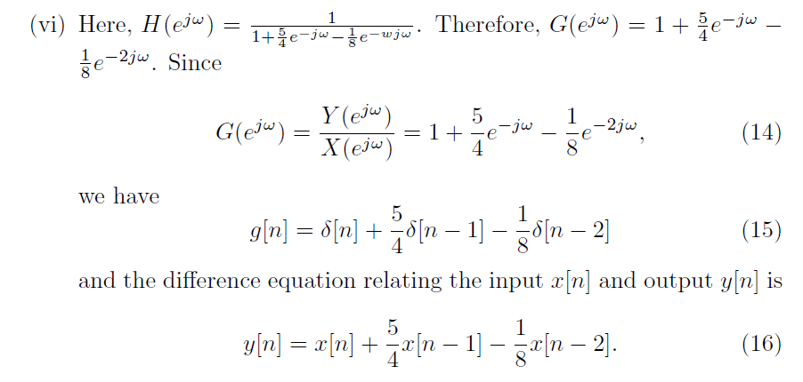

Slide 15
